Slide 1


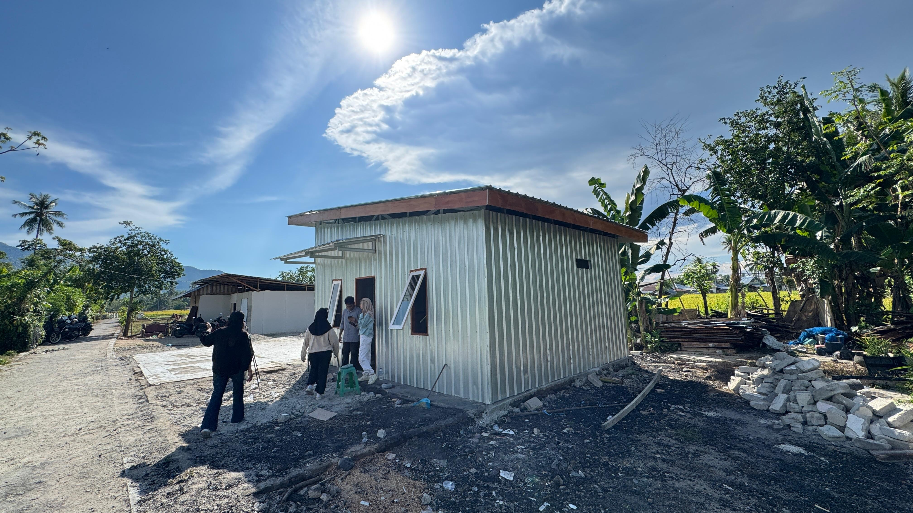

UNIVERSITAS
NEGERI GORONTALO
Thermal Performance of a Solar Reflective Metal House in the Tropical Climate of Gorontalo, Indonesia
T M Al-Aiyubi*, Rahmayanti, N Pratiwi, N Mutmainnah, Syafriyani, W Saputra
Department of Architecture, Universitas Negeri Gorontalo, Gorontalo, Indonesia
*Emai : aiyubi@ung.ac.id
International Symposium and Workshop
on Sustainable Buildings, Cities, and Communities.
“A Sustainable Cooling for Cities: Designing for Hot and Humid Climates”

Slide 2
Introduction
UNIVERSITAS
NEGERI GORONTALO
Metal roofs and walls are widely used but have high thermal conductivity, causing indoor temperatures to rise 2–6°C compared to non-metal materials.
Reflective paint (cool roofs) offers an effective passive solution by reflecting solar radiation and reducing roof and wall surface temperatures.
Previous studies show reflective coatings can lower surface temperature by up to 6.6°C and indoor temperature by 9–12°C, improving thermal comfort without extra energy use.
Research in Gorontalo remains limited, especially full before–after thermal assessments of metal houses; this study evaluates their thermal performance and the effectiveness of reflective coatings for affordable tropical housing.
Thermal Performance of a Solar Reflective Metal House in the Tropical Climate of Gorontalo, Indonesia | T. M. Al-Aiyubi

Slide 3
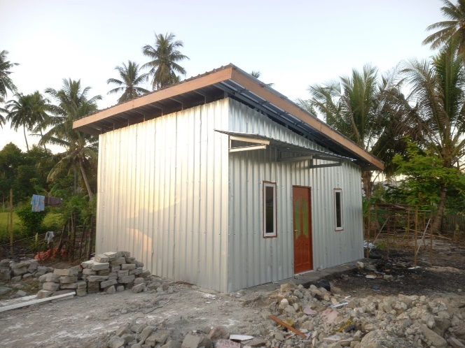
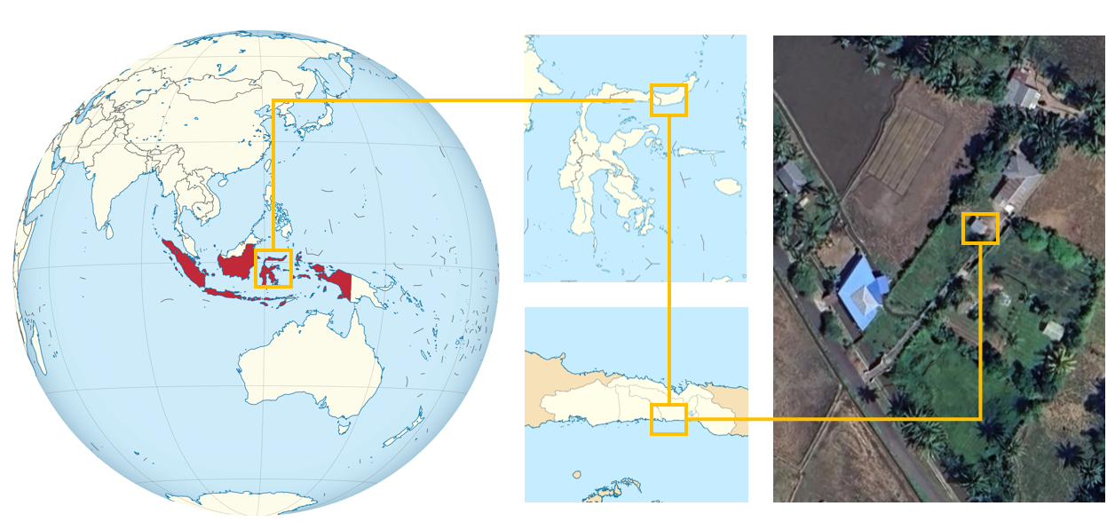
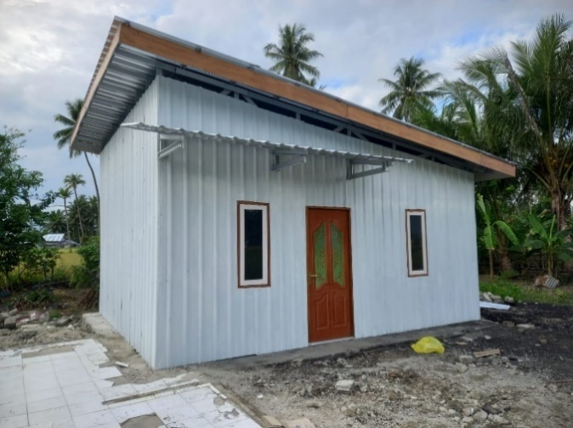
Method
UNIVERSITAS
NEGERI GORONTALO
This study was conducted at a BeCool CSR project house in Dutohe Village, Bone Bolango Regency, Gorontalo, at coordinates 0°32'37.3" N and 123°07'10.7" E.
Figure 1. BeCool House Location
Figure 2. Pre-Painting & Post-Painting
Thermal Performance of a Solar Reflective Metal House in the Tropical Climate of Gorontalo, Indonesia | T. M. Al-Aiyubi

Slide 4
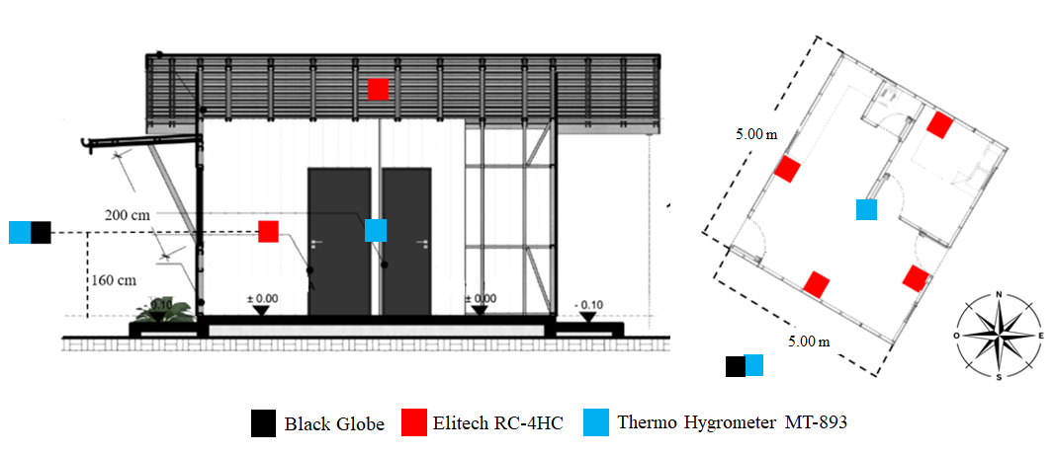
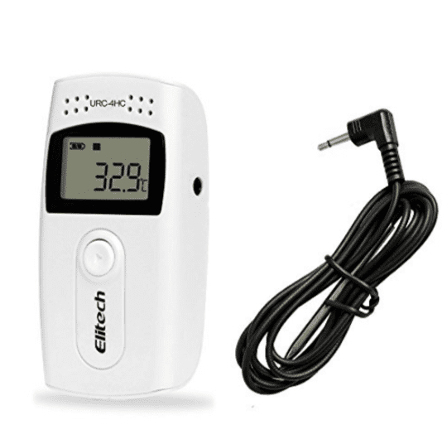
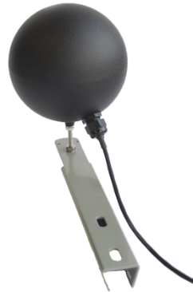
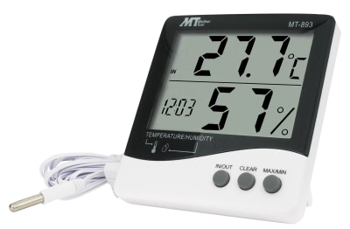
Method
UNIVERSITAS
NEGERI GORONTALO
This study employed a direct measurement approach conducted in two phases: before and after the application of reflective paint to the building surfaces.
Data collection utilised an Elitech RC-4HC to record surface and black-bulb temperatures, and an MT-893 Thermo-Hygrometer to measure indoor and outdoor air temperatures and humidity (Figure 3)
All instruments were positioned on each wall at 160 cm above the floor, as well as on the roof surface. Additional black-bulb temperature measurements were recorded outside the building (Figure 4).
Figure 4. Measurement Point
Figure 3. Measurement Tools
Thermal Performance of a Solar Reflective Metal House in the Tropical Climate of Gorontalo, Indonesia | T. M. Al-Aiyubi

Slide 5
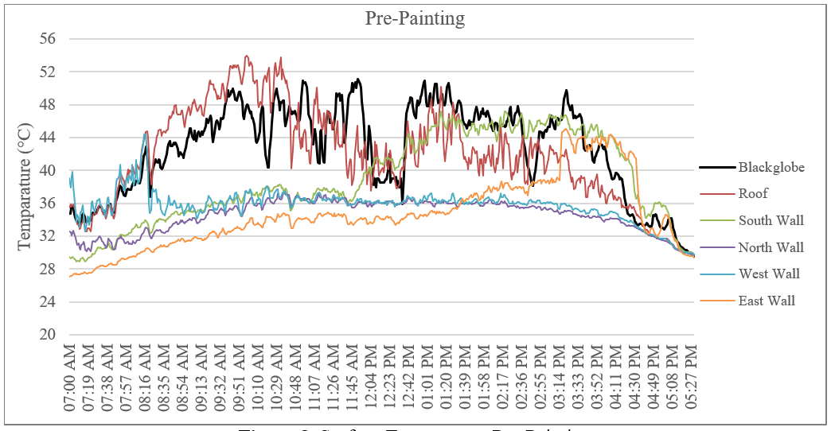
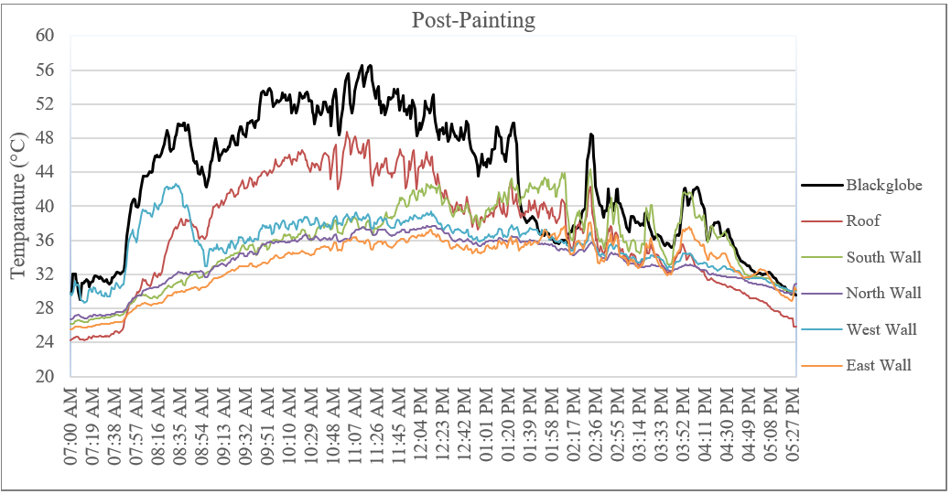
Result and Discussion
UNIVERSITAS
NEGERI GORONTALO
Surface temperatures increase significantly between 11:00 and 15:00, with the roof being the hottest element, followed by the south and east walls.
Reflective paint effectively reduces temperatures across all building elements, with the greatest reductions on the roof (4–5°C) and the east wall (up to 7°C).
Walls with lower solar exposure (north and west) show only minor reductions (about 1–2°C), indicating that effectiveness is strongly influenced by orientation.
Overall, reflective paint is an effective passive strategy for reducing heat accumulation in buildings in tropical climates.
Figure 5. Surface Temperature Pre-Painting & Post-Panting
Thermal Performance of a Solar Reflective Metal House in the Tropical Climate of Gorontalo, Indonesia | T. M. Al-Aiyubi

Slide 6
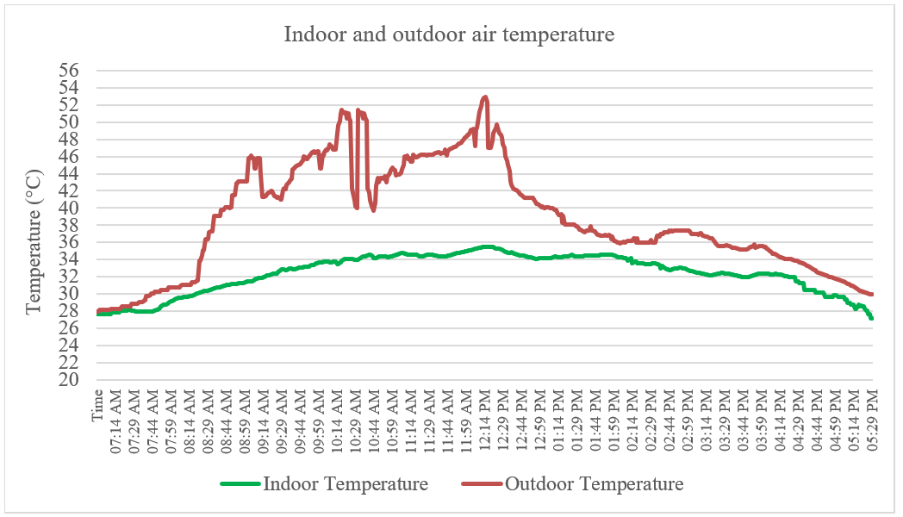
Result and Discussion
UNIVERSITAS
NEGERI GORONTALO
Reflective paint significantly reduces heat absorption on building surfaces, resulting in a much smaller increase in indoor temperature compared to the sharp rise of outdoor temperature, which can exceed 50°C.
Indoor temperatures remain relatively stable (33–35.5°C) despite large fluctuations outdoors, showing that reflective paint effectively minimizes sudden thermal changes.
A substantial temperature difference of 16–17°C between indoor and outdoor conditions during peak heat hours confirms the strong role of reflective paint in limiting heat transfer into the building.
Reflective paint does not cool the room directly, but reduces solar radiation and heat absorption on surfaces, thereby decreasing heat gain and improving indoor thermal comfort under extreme outdoor temperatures.
Figure 6. Difference in indoor and outdoor air temperature
Thermal Performance of a Solar Reflective Metal House in the Tropical Climate of Gorontalo, Indonesia | T. M. Al-Aiyubi

Slide 7
Conclusion
UNIVERSITAS
NEGERI GORONTALO
Reflective paint effectively improves thermal performance by reducing surface heat absorption and keeping indoor temperatures more stable.
Despite extreme outdoor conditions with temperatures above 50°C, indoor temperatures increase more slowly, with differences reaching 16–17°C during peak heat hours.
Stable indoor temperature and humidity show that reflective paint reduces heat transfer and mitigates sudden thermal fluctuations.
Future studies should include long-term monitoring and tests on different colours, materials, and weather conditions to assess durability and effectiveness in tropical climates.
Thermal Performance of a Solar Reflective Metal House in the Tropical Climate of Gorontalo, Indonesia | T. M. Al-Aiyubi

Slide 8
References
UNIVERSITAS
NEGERI GORONTALO
R. Yin, H. C. Putra, and R. Levinson, “Evaluation of various passive cooling solutions in decarbonizing the Indonesian residential building sector in tropical climates,” 2024.
S. Adela Putri, “Vegetation and cool materials on building envelopes: Impacts on indoor temperature and energy use in Indonesian tropical residential buildings,” 2024, doi: 10.5258/SOTON/P1198.
P. Łapka, F. Dietrich, P. Furmański, M. Sinka, G. Sahmenko, and D. Bajare, “Experimental and numerical estimation of thermal conductivity of bio-based building composite materials with an enhanced thermal capacity,” J. Energy Storage, vol. 97, p. 112943, 2024, doi: 10.1016/j.est.2024.112943.
………
Research / Invention Title / Design / Patented Product | Lead Researcher

