Slide 1
Linking Daylight Illuminance and Internal Heat Gains in a Tropical Room Model
M. S. S. Purnama, B. P. Alam, O. S. Tiara, N. R. Dewi, R. Rejoni
Architecture Department, University of Indraprasta PGRI, Jakarta, Indonesia

Slide 2
Introduction
High cooling energy demand in tropical buildings
  Hot–humid climate: high solar radiation and internal loads
  Passive cooling as key sustainability strategy
  Artificial lighting contributes to internal heat gains
  Need to link daylight performance with cooling potential

Slide 3
Literature Review
Passive cooling focuses on envelope and ventilation strategies
  Shading devices reduce solar heat gains
  Daylighting studies prioritize visual comfort
  Limited integration of daylight and cooling performance
  Illuminance rarely linked to internal heat reduction

Slide 4
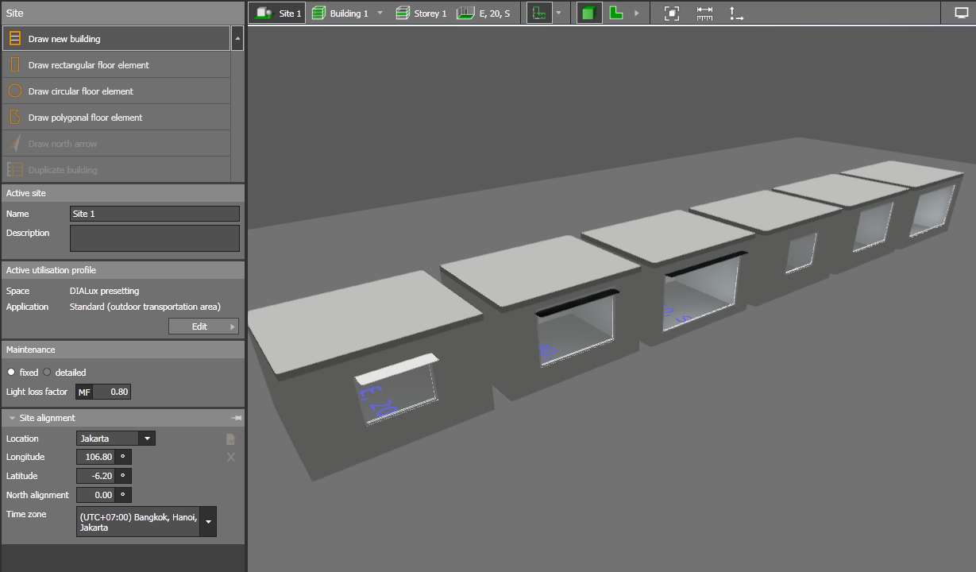
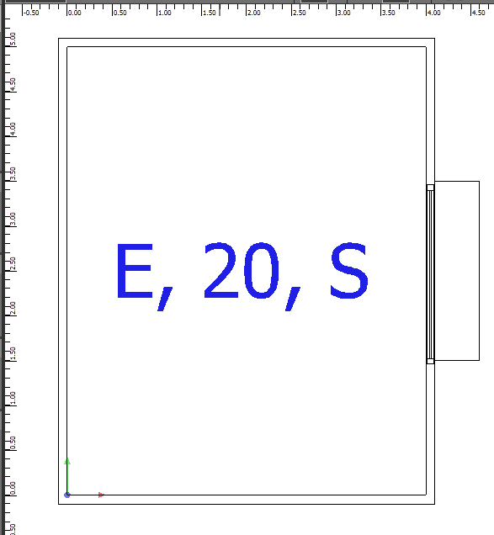
Method
Simulation-based quantitative approach
  Office-like room: 4 m × 5 m × 3 m height
  Variables: WWR, orientation, shading
  24 façade configurations evaluated
  Daylight simulation using DIALux

Slide 5
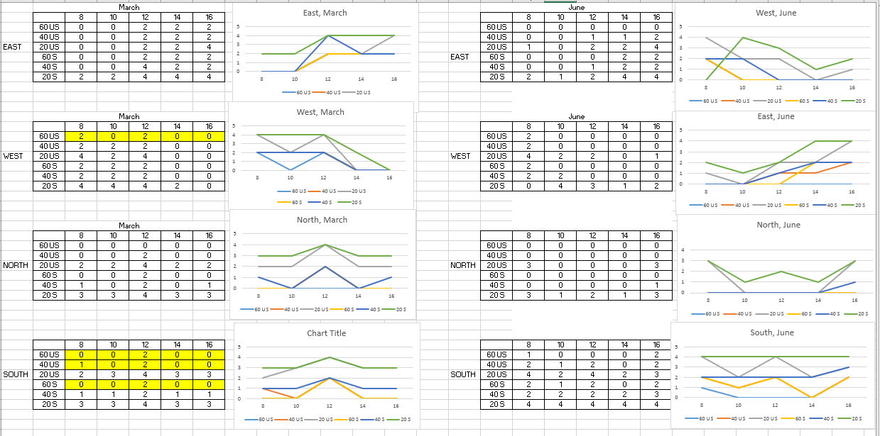
Findings

Slide 6
20% WWR requires highest artificial lighting
  Larger WWR does not ensure daylight sufficiency
  East and west façades critical after midday
  Shading alters daylight distribution patterns
  Orientation strongly influences lighting demand

Slide 7
Discussion
North and south façades show superior performance
  Unshaded façades reduce lighting but increase heat gain
  Shading balances daylight and thermal control
  Illuminance affects lighting-related heat gains
  Façade design critical for passive cooling integration

Slide 8
Conclusion
Daylight illuminance links visual and thermal performance
  WWR and orientation affect lighting energy demand
  Shading necessary to control solar heat gains
  Integrated façade design supports passive cooling
  Useful framework without full thermal simulation

Slide 9
References
Nqoro et al. (2025). International Journal of Energy Research.
  Hatoum et al. (2025). Building and Environment.
  Manshour & Lehmann (2025). Frontiers in Built Environment.
  Iskandar et al. (2024). Energy and Buildings.
  Sezgen & Koomey (2000). Energy.

