Slide 1
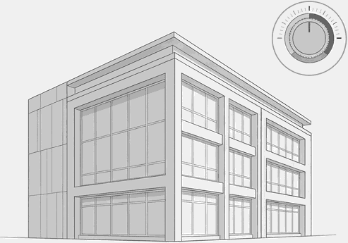
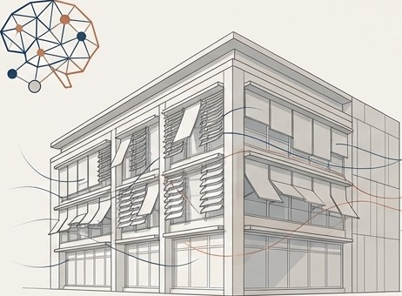
From Reactive to Predictive: A New Paradigm for Climate-Responsive Architecture
The Old Paradigm (Reactive)
Systems respond to existing problems.
Relies on constant, energy—intensive r«echanicei coollng end dehumldificetion.
Architecture is static.
The New Paradigm (Predictive)
Systems anticipate future conditions.
Activates passive and active controls with precision.
Enables dynamic, adapt+ve architecture that works with the climate.
How integrating future climate data, AI, and adaptive systems is creating buildings that anticipate, learn, and respond.

Slide 2
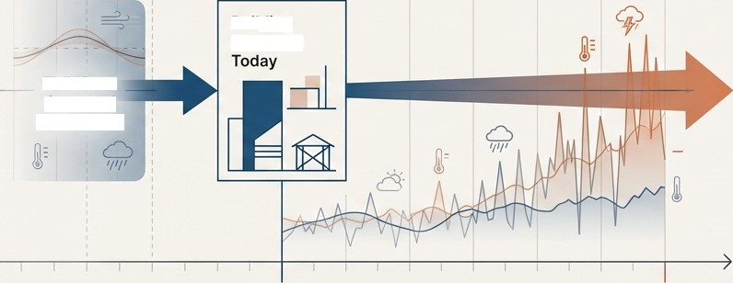
Our Buildings Are Designed for a Climate That No Longer Exists
The current architectural design process is built on a critical vulnerability: its reliance on historical weather data.
Building Lifespan
(50-80 years)
Typical Meteorological Year (TMY) files, the industry standard for energy modeling and performance simulation, are based on weather data that can be over 30 years old (e.g., TMY2 uses 1961-1990 data; TMY3 uses 1976-
2005).
Building
Designed
TMY Data Captured (1961-1990)
These files represent past median conditions, failing to account for the increasing frequency and intensity of extreme weather events and the clear trajectory of climate change.
Present
Future
(2025-2100)
G NotebookLM

Slide 3
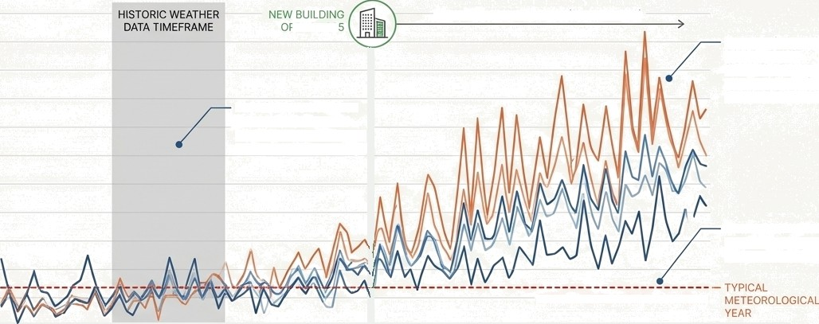
We Are Modeling for the Average While Designing for the Extreme
RISKS OF USING HISTORIC WEATHER DATA FOR BUILDING DESIGN
55
NEW BUILDING LIFESPAN (50-80 YEARS)
50
45
’ENS 202
A new building will operate in this future, facing climate stresses its design naver anticipated.
40
TMY filea ere beeed on thls nerrow, historical window, representlng en outdeted climate reelity.
35
30
2S
20
The TMY smooths out
extremes, representing
a deceptively stable past
15
10
5
TYPICAL METEOROLOGICAL YEAR
1960
1980
2000
-Observed —Warrij/Dry
2025 2040
—Cool/wet —Average —Complement
2060
2080
2J00
Relying on historical averages to design 50-year assets is no longer
a viable engineering practice; it is a critical design failure.

Slide 4









The Future Impact on Building Performance is Not Minor. It is Systemic.
Modeling standard building prototypes with future climate files (SSP245, 2080-2099) reveals that
systems designed to today‘s code will be severely undersized and inefficient.
Design CFM (Ventilation) Change (%)
Small Office
Design Cooling Load Change (%)
Small Office
Outpatient Healthcare
Primary School
Hotel (Large) Secondary School Mid-rise Apartment
Standalone Retail
High-rise Apartment
Warehouse Hospital
Restaurant (Fast Food)
Restaurant (Sit Down)
—40%
Restaurant (Fast Food) Outpatient Health Care
Medium Office Hotel (Large) Primary School
Restaurant (Sit Down)
Secondary School
Hospital
*20P.
20%
32%
+30%
+30%
-3%
Large Office
Mid-riSe Apartment
Warehouse
Strip Mall I*3%
Standalone Retail
Small Hotel I 1%
0' 10% 20& 30& 406 50& 60& 70&
—20&
0%
20& 406 60B
Future climate will demand significantly higher cooling loads and ventilation rates. Systems sized
using historical data will fail to maintain comfort, operate inefficiently, and face premature failure.

Slide 5
A Fundamental Shift is Required:
From Reactive Systems to Predictive Architecture
The Old Paradigm (Reactive)
The New Paradigm (Predictive)
Description
Systems respond to existing problems. Relies on constant, energy-intensive mechanical cooling and dehumidification. Architecture is static and works against the climate.
Description
Systems anticipate future conditions. Activates passive and active controls with precision. Architecture is dynamic, intelligent, and works with the climate.

Slide 6




The Three Pillars of the New Paradigm
Future-Forward Data
Predictive Intelligence
Responsive Systems
Moving beyond historical TMY files to utilize downscaled, high-resolution future climate projection data (e.g., SSP Scenarios). This provides a scientifically robust basis for designing buildings that will perform over their entire lifespan.
Leveraging Artificial Intelligence and Machine Learning to analyze complex datasets, predict thermal behavior, and optimize system performance in real-time. This is the engine of anticipatory control.
Deploying an ecosystem of IoT
sensors and adaptive components.
Real-time data from sensors (environmental, wearable) feeds the AI, which directs actuators in smart
facades and ventilation systems to
respond proactively.

Slide 7




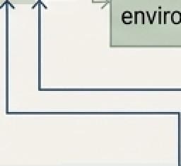
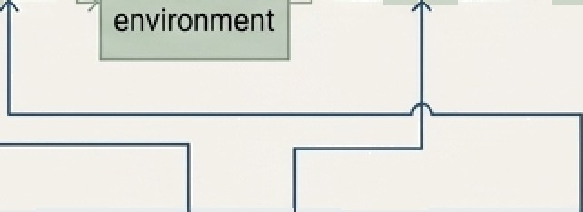
The Engine of Prediction:
From Simple Feedback to Intelligent Control
Traditional Method
Al—based Approach
Energy consumption
Energy consumption
Energy management system
Building facilities
Occupant
behavior
Outdoor
environment
Energy management system
Bullding facilities
_
Occupant
behavior
Outdoor
environment
Indoor
environment
Indoor ”, “ environments
Remote sensing (Sensors, Cameras, Wearabie devices) | ' | Communication technology (Internet of Things) | “ | Cloud computing (Intelligent algorithms and solutions)
Key Insight: Traditional building management is a one-way street based on simple thresholds. AI creates an intelligent, multi-directional ecosystem that learns from occupant behavior and environmental data to optimize the entire system, not just react to a single data point.

Slide 8
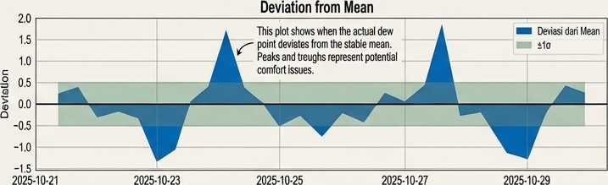
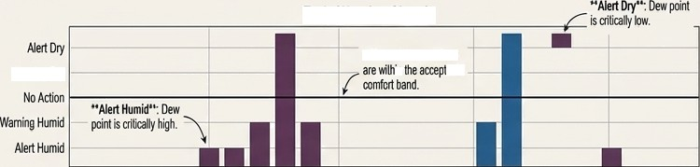
The Paradigm in Action: A Case Study in Proactive Humidity Control
Context: In hot-humid climates, high humidity degrades comfort and risks material damage (mold, condensation). Reactive systems only act after conditions become critical.
Solution Framework
  Data: A time-series dataset of indoor Dew Point measurements from IoT sensors.
Predictive Model: An 0rnstein-Uhlenbeck (OU) stochastic model forecasts the dew point's path, leveraging its tendency to revert to a long-term mean. This allows the system to anticipate deviations.
Intelligence: A multi-level Early Warning System (EWS) tracks the real-time deviation between the actual sensor data and the model's predicted mean.
Early Warning Signals
’70MBltfl0fldb0B
Wami#D
202510 21
20Z5 10 23
2025 10 25
2025-10 27
2025-1&29

Slide 9
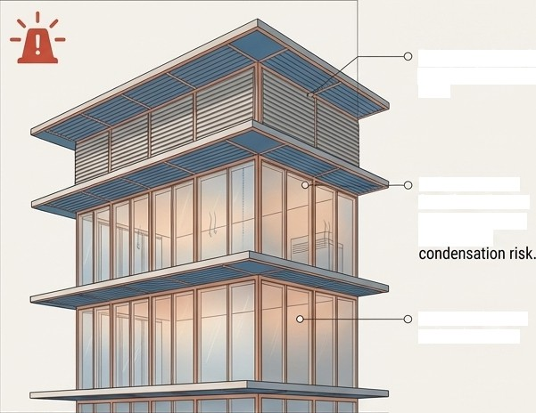
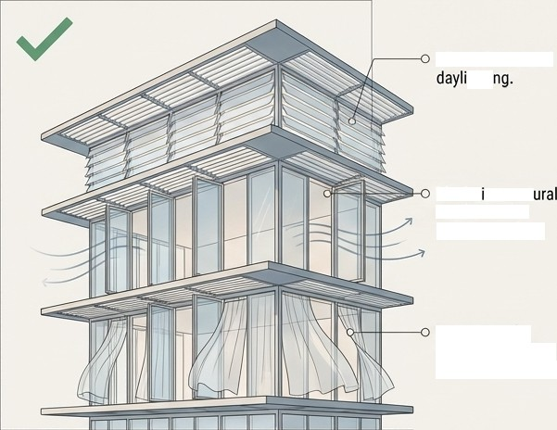
From Intelligent Signal to Architectural Response
‘ALERT HUMID’ SIGNAL
‘NORMAL’ SIGNAL
Reduces solar gain to minimize cooling loud.
Allows for natural
ghti
isolates interior from humid air to prevent moisture ingress and
Maxim zes nat ventilation for passive cooling.
Dehumidiflcation action is active.
Optimizing fof occupant comfort and energy effielency.
The building is no longer a static shell; it is a responsive organism that modifies its
skin to maintain optimal internal conditions based on predicted needs.

Slide 10

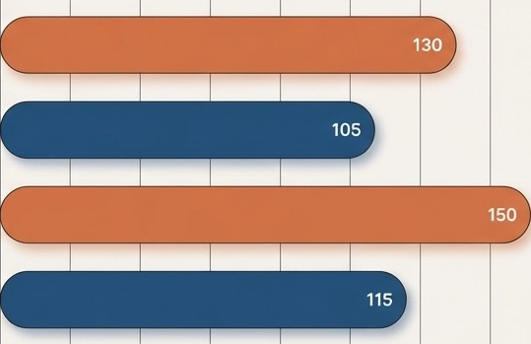

The Quantifiable Impact: Data-Driven Performance Gains
Integrating machine learning predictors (LightGBM) with optimization algorithms (Energy Valley Optimizer) allows for early-stage design choices that yield dramatic energy savings.
40% Reduction
Composite façades achieved up to a 40% decrease in energy use compared to glass and metal alternatives.
Energy Consumption (kWhlm*): Traditional vs. Optimized Designs
Traditîonal Residential
35 kWh/m² Savings
In high-rise officer, optimizing the Window-to- Wall Ratio (WWR) reduced annual energy demand by 35 kWh/m².
Optimized Residential
Traditional
High-Rise Office
,¿> 20-30% Improvement
Climate-specific adaptive strategies resulted in 20a to 30% improved energy efficiency across diverse tropical and polar climates.
Optimized High—Rlse Office
0
20
40
60
80
100
120
140
160
Data from "Machine Learning for Adgptive Facade Design- Enhancing Thermal Performance in Urban Architecture" (Ghoneim, 2025).

Slide 11
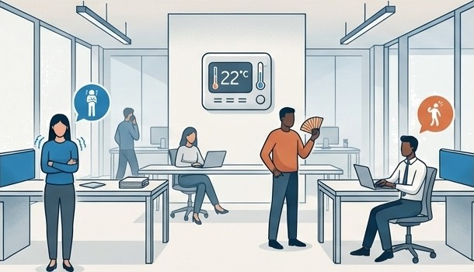
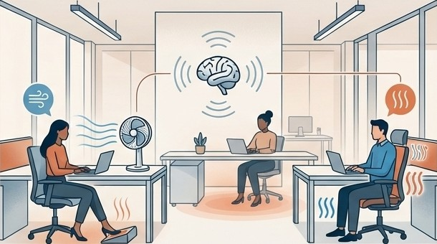
Beyond Building E0iciency: Engineering Personalized Comfort
The Old Standard: Conventional HVAC systems are designed to satisfy 80% of occupants, accepting that 20% will be uncomfortable. This one-size-fits-all approach is inefficient and fails to account account for personal differences (metabolic rate, clothing, gender).
The New Capability: Al-driven systems can learn individual thermal preferences over time by correlating environmental data with physiological feedback from non-intrusive sensors.
CONVENTIONAL ONE-SIZE-FITS-ALL
PERSONALIZED AI-DRIVEN COMFORT
The goal shifts from conditioning the space to conditioning the person,
delivering tailored comfort with maximum energy efficiency.

Slide 12












Integrating Predictive Design into the Professional Workflow
The new paradigm does not require abandoning existing tools, but rather augmenting them with future-forward data and Al-driven analysis.
CLIMATE/SITE ANALYSIS
LADYBUG
BUILDING ORIENTATION & FORM
,
CLIMATESTUDIO
SOLAR IRRADIATION
COVE.TOOL
ENERGYPLUS
DAYLIGHTING
8GLARE
REVIT/INSIGHT360
FUTURE CLIMATE WEATHER FILE
BUILDING ENVELOPE
ARCHSIM
CONCEPTUAL ENERGY
DESIGNBUILDER
The weather file remains the single source of truth, but by updating it with future climate projections, the entire suite of analysis and simulation tools becomes resilience-focused.

Slide 13
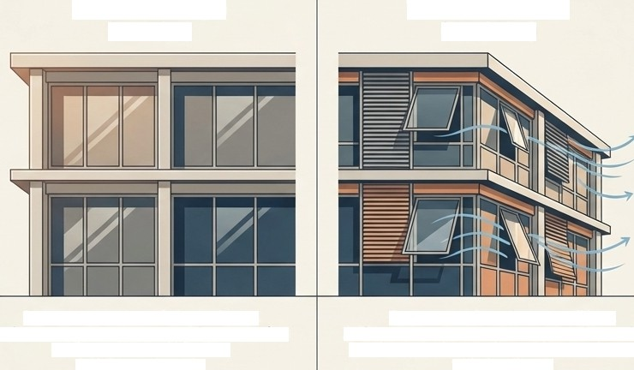


The Imperative is Clear: Architecture Must Evolve
Climate change has rendered our traditional, static design philosophy obsolete. To create buildings that are truly sustainable and resilient, we must move beyond reacting to the present and begin designing for the future.
The Old Paradigm
(Reactive)
The New Paradigm
(Predictive)
Systems respond to existing problems.
Relies on constant, energy-intensive mechanical cooling and dehum!dification.
Architecture is static.
Systems anticipate future conditions.
Activates passive and active controls with precision. Enables dynamic, adaptive architecture that works with the climate.
This is more than a technological upgrade; it is a necessary evolution of our professional mindset. It requires us to embrace data,
leverage intelligence, and design buildings that are not just shelters, but living systems in tune with their environment.

Slide 14
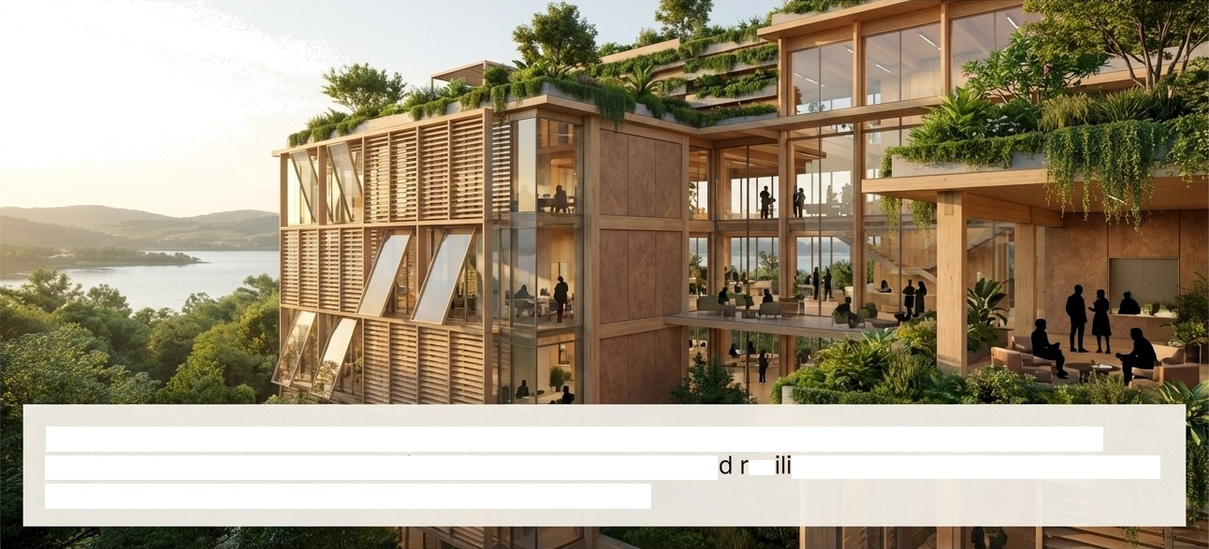
An Architecture That Senses, Thinks, and Responds
By integrating predictive intelligence into the core of the design process, we can create a built environment that is not only profoundly more sustainable an es ent, but also more attuned to the comfort, health, and well-being of the people within it.

