Slide 1


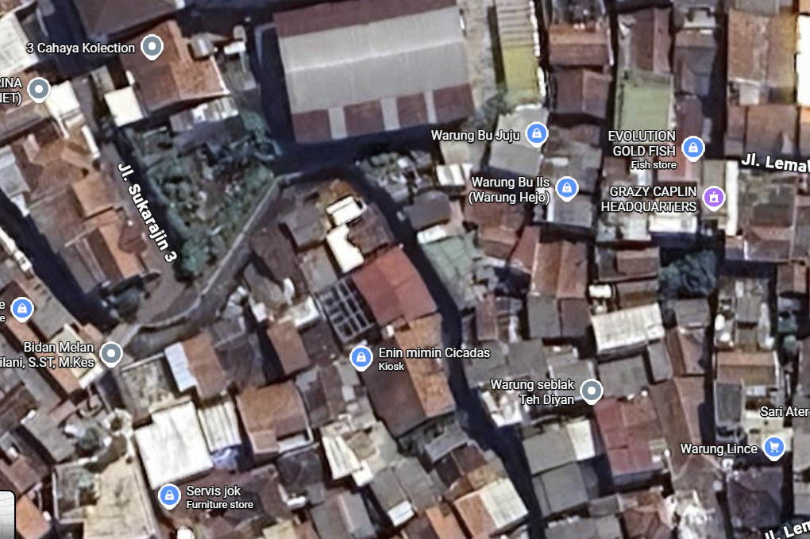
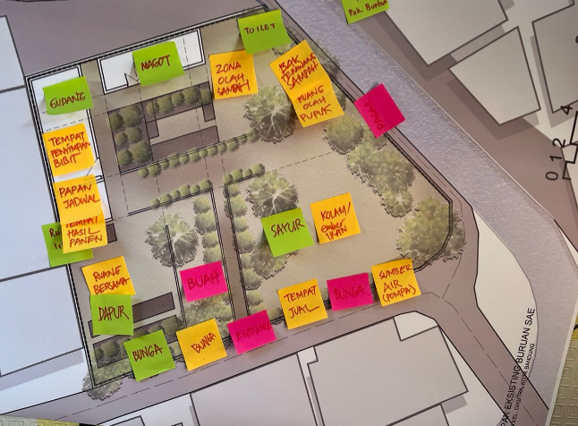
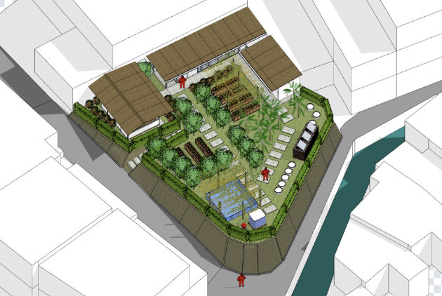

Green Pocket Urban Farming: The Effectiveness of The Buruan SAE Program as an Urban Cooling Mechanism
Kunthi Herma Dwidayati (dwidayati@upi.edu), Yudhistira Kusuma, Nitih Indra Komala Dewi, Annisaa Shabrina Amri
International Symposium and Workshop
on Sustainable Buildings, Cities, and Communities.
“A Sustainable Cooling for Cities: Designing for Hot and Humid Climates”

Slide 2
Introduction
Universitas Pendidikan Indonesia
The concept of urban agriculture integrated with the Buruan SAE program is an effort to sustainably increase food security and self-sufficiency. The Buruan SAE program is an innovative program that integrates waste management into compost with agricultural, livestock, and fisheries systems. The term Buruan SAE is derived from the Sundanese language: "Buruan," meaning "yard," and "SAE," an abbreviation for "Healthy, Natural, and Economical." The program, launched in 2020, has been implemented in various sub-districts across Bandung City and has established up to 375 groups. The Bandung City Government's target is to increase the number of groups to 100 by 2024 (DKPP Kota Bandung, 2020)(Diskominfo, 2024).
Highly populated urban areas like Bandung often experience rising temperatures and declining environmental quality due to limited green space and excessive heat retention from building surfaces (Rahman et.al, 2024). As an intervention, the Buruan SAE program—implemented on small residual plots within dense neighbourhoods offers a green pocket strategy that enhances both community-based food security and the microclimate quality of the surrounding area.
Green Pocket Urban Farming: The Effectiveness of The Buruan SAE Program as an Urban Cooling Mechanism
| Kunthi Herma Dwidayati

Slide 3
Universitas Pendidikan Indonesia
The aim of this research is to improve the quality of the Buruan SAE urban farming area through the implementation of community-based architectural design and measure its effectiveness, so that it is expected to increase the area of ​​green areas, agricultural productivity for community food independence, build environmental awareness and become an area cooling system in dense urban areas.

Slide 4
Method
Universitas Pendidikan Indonesia
The study adopts a Participatory Action Research (PAR) framework to understand community engagement, spatial transformations, and design adaptations within the Buruan SAE site
PAR is combined with environmental field measurements to evaluate microclimate outcomes following the implementation of green pocket urban farming interventions.
The location at Buruan SAE site RW.06 Cikutra Bandung city. The research design divided into two component, namely preliminary assessment (mapping the physical condition, identify existing vegetation, documenting initial microclimate condition, and informal interview with community) and also community participation and co-design (Focus Group Discussion during design process)
Green Pocket Urban Farming: The Effectiveness of The Buruan SAE Program as an Urban Cooling Mechanism
| Kunthi Herma Dwidayati

Slide 5
Result and Discussion
Universitas Pendidikan Indonesia
Through a Participatory Action Research (PAR) approach, residents, Buruan SAE cadres, and local community leaders collaboratively redefined the spatial function of the land. Focus Group Discussions (FGDs) facilitated the identification of priority needs, including improved security, boundary clarification, circulation access, and zoning for planting areas. The collaborative design process resulted in a more structured layout and an organized planting scheme, demonstrating a significant shift from unmanaged open space to a functional green pocket that supports community activities and enhances the environment.
Green Pocket Urban Farming: The Effectiveness of The Buruan SAE Program as an Urban Cooling Mechanism
| Kunthi Herma Dwidayati

Slide 6
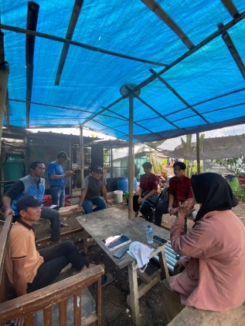
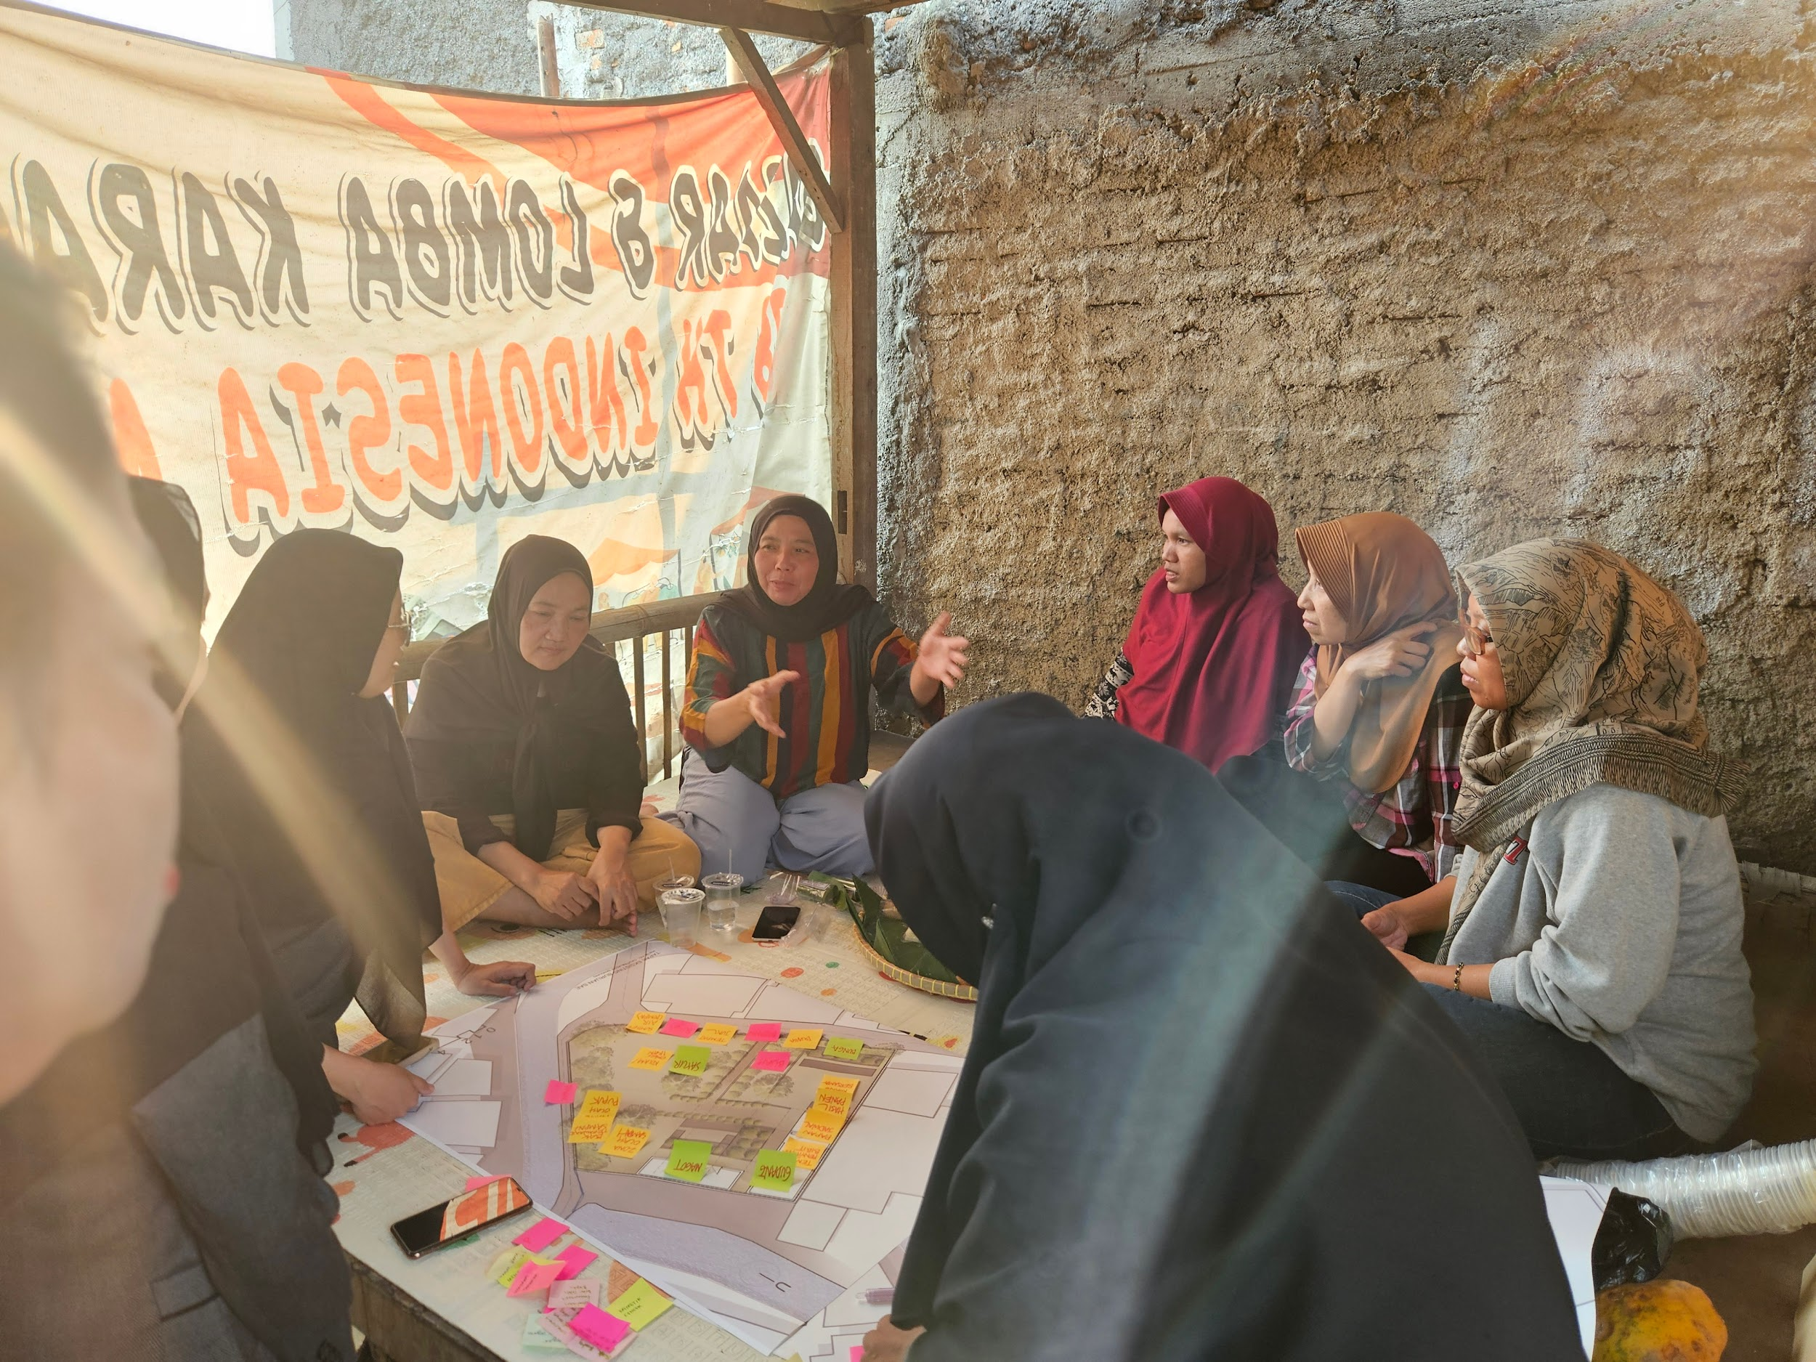
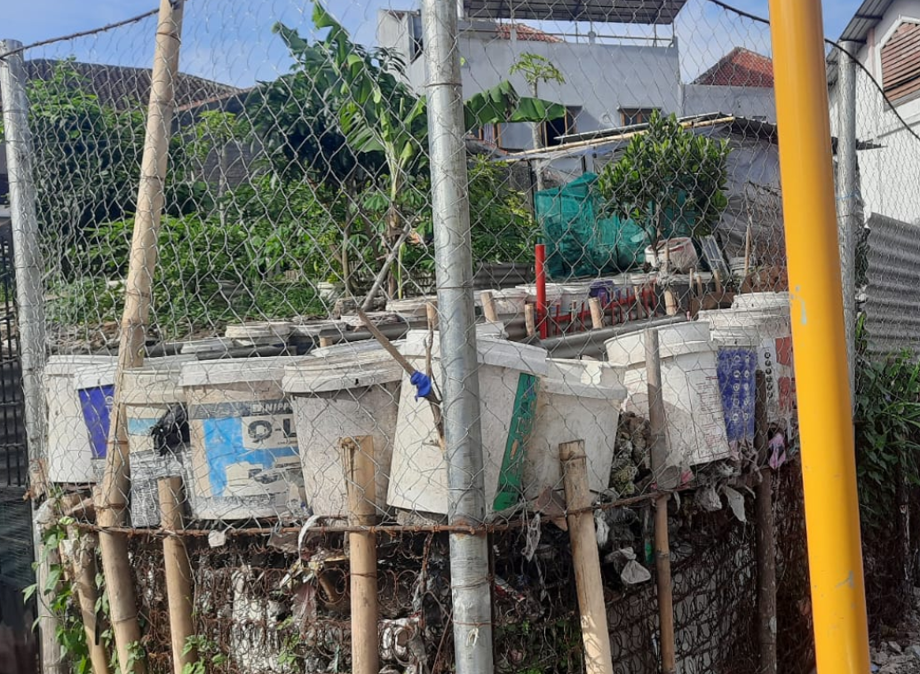
Result and Discussion
Universitas Pendidikan Indonesia
Microclimate observations conducted during the initial and post-intervention phases showed that the vegetation and soil-based planting areas contributed to measurable improvements in thermal conditions. Vegetated zones exhibited noticeably lower surface temperatures compared to adjacent hard surfaces such as concrete walls, paving, and corrugated metal roofs. This aligns with the literature on vegetation’s capability to reduce heat storage and reflectivity. Trees, shrubs and vertical greenery showed a temperature decrease of several degrees celsius, particularly at midday when solar exposure peaked. The presence of leafy crops, vines, and fruit plants increased evapotranspiration, which enhanced local humidity and reduced ambient air temperature. Even in small plots, this natural cooling mechanism created a more comfortable microclimate for both residents and visitors.
Green Pocket Urban Farming: The Effectiveness of The Buruan SAE Program as an Urban Cooling Mechanism
| Kunthi Herma Dwidayati

Slide 7
Conclusion
Universitas Pendidikan Indonesia
The findings demonstrate that Buruan SAE plays a dual role in Bandung’s dense urban environment. First, it strengthens food self-sufficiency and community resilience. Second, it contributes measurable microclimate improvements through shading, evapotranspiration, and reduced heat retention. When integrated into the city at scale, Buruan SAE becomes a critical climate-responsive strategy that enhances thermal comfort and supports sustainable urban development.
Green Pocket Urban Farming: The Effectiveness of The Buruan SAE Program as an Urban Cooling Mechanism
| Kunthi Herma Dwidayati

