Slide 1
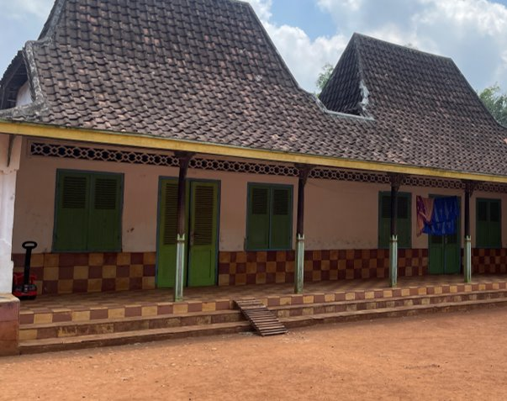
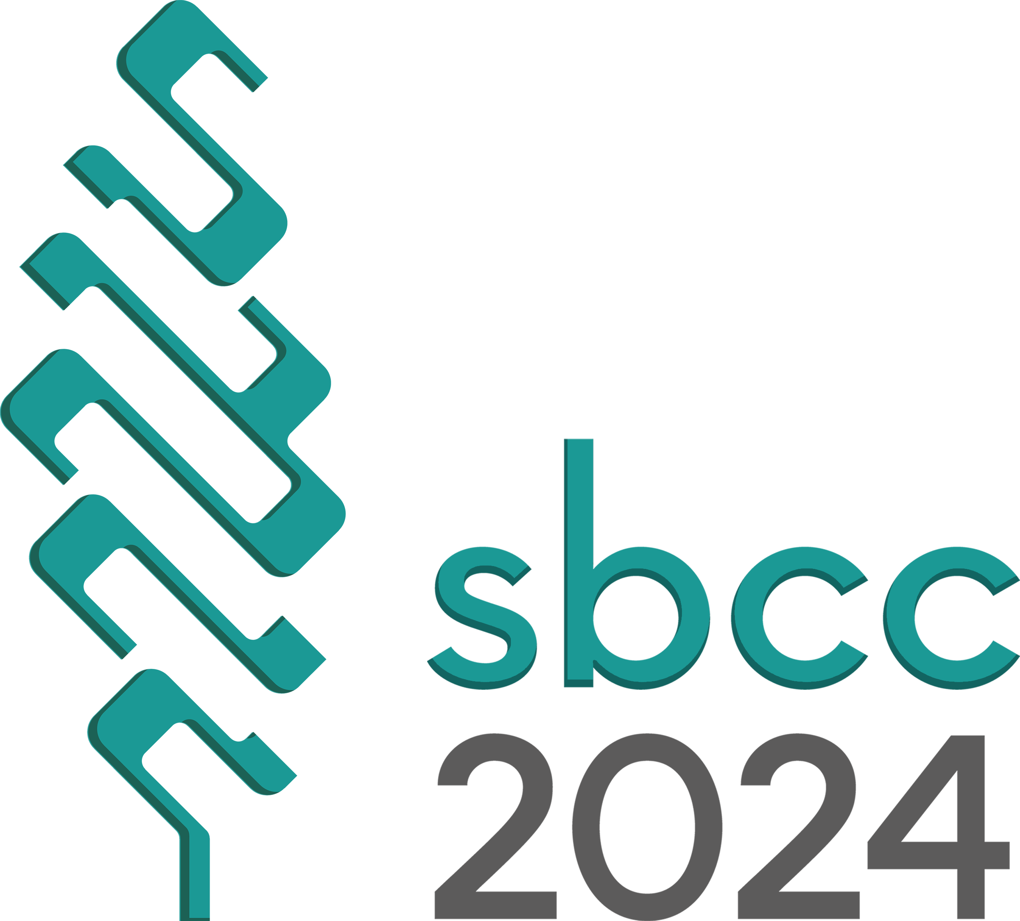
Adapting Modernization in Traditional Architecture: An Investigation on Sustainability Principles of Taneyan Lanjhang Madura
Didit Novianto/Lecturer (didit.novianto@its.ac.id), R T Hidayat/Research Assistant, A E Sumanti/Master Student, W Yao/Professor, A M Jaya/Lecturer

Slide 2
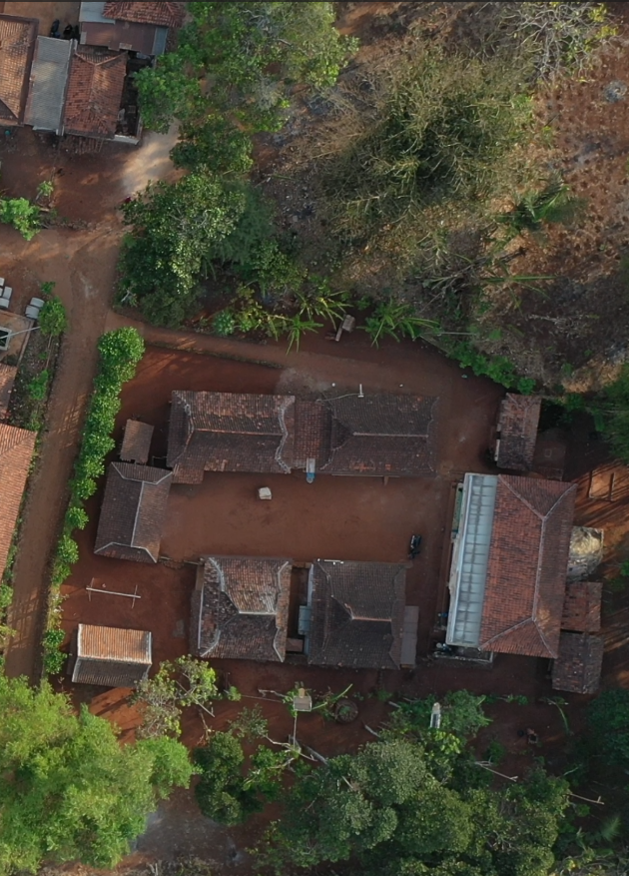
Introduction
Modernization
The influence of the modern era has overshadowed the building techniques, making it challenging to develop them again up to the present.
Madura's Traditional Architecture
Known as Taneyan Lanjhang (TL), is a traditional house characterized by a housing concept featuring a long yard. TL serves as a subject of study illustrating how the local Madurese community has adapted to modernization across various aspects such as building function, employment types, and lifestyle.
Research Aim
This research was conducted to investigate these unplanned developments and changes, so that the findings can be used as material and references for designers in developing sustainable Nusantara architecture while still accommodating the modern lifestyle of its users.
Adapting Modernization in Traditional Architecture | Didit Novianto

Slide 3
Literature Review
Taneyan Lanjhang
This traditional house consists of several components, namely Langgar (prayer room), Tongguh (main house), followed by other houses generally aligned from west to east (according to the family order), a kitchen, stables, and a Taneyan (courtyard) [1].
The long yard/courtyard located in the middle of the house is what is referred to as TL [2].
TL is characterized by its main building orientation always facing south, a roof shape similar to a Joglo with specific ornaments on the ridge, and one door at the front [3].
The Influence of modern era in Madura and Nusantara Architecture
The changes that become challenges to Nusantara Architecture include those resulting in environmental changes, the development of industries that produce variety of building material, construction, to equipment, the growth of science and technology, and even politics [4].
Bangkalan Regency area, which experiences significant increases every year [5].
There is an influence from the inhabitants who have worked abroad for years and then have the means for renovation upon returning to Madura. The increase in income indicates that there has been an increase in community productivity [6].
Although modernization and the use of new materials have entered traditional home design, distinctive cultural elements are still maintained in various ways [7].
Adapting Modernization in Traditional Architecture | Didit Novianto

Slide 4
Method
Site survey and Depth Interview.
The research through field observations and interviews to more than 30 houses in 5 hamlets carried out for a week during the hot season, conducted in the Bangkalan Regency area, Alang-Alang Village.
Building identification, measurement and documentation of floor plans, views, sections of houses including air photographs using drones were carried out.
The interview consists of household’s basic information, lifestyle data, functional and physical changes to the house, and the ownership of appliances.
2. Environmental Measurements
Temperature and humidity measurements are carried out using ThermoRecorder at several representative houses to investigate the living environmental condition and to understand the value and the correlation of vernacular architecture with occupants' lifestyle.
Adapting Modernization in Traditional Architecture | Didit Novianto

Slide 5
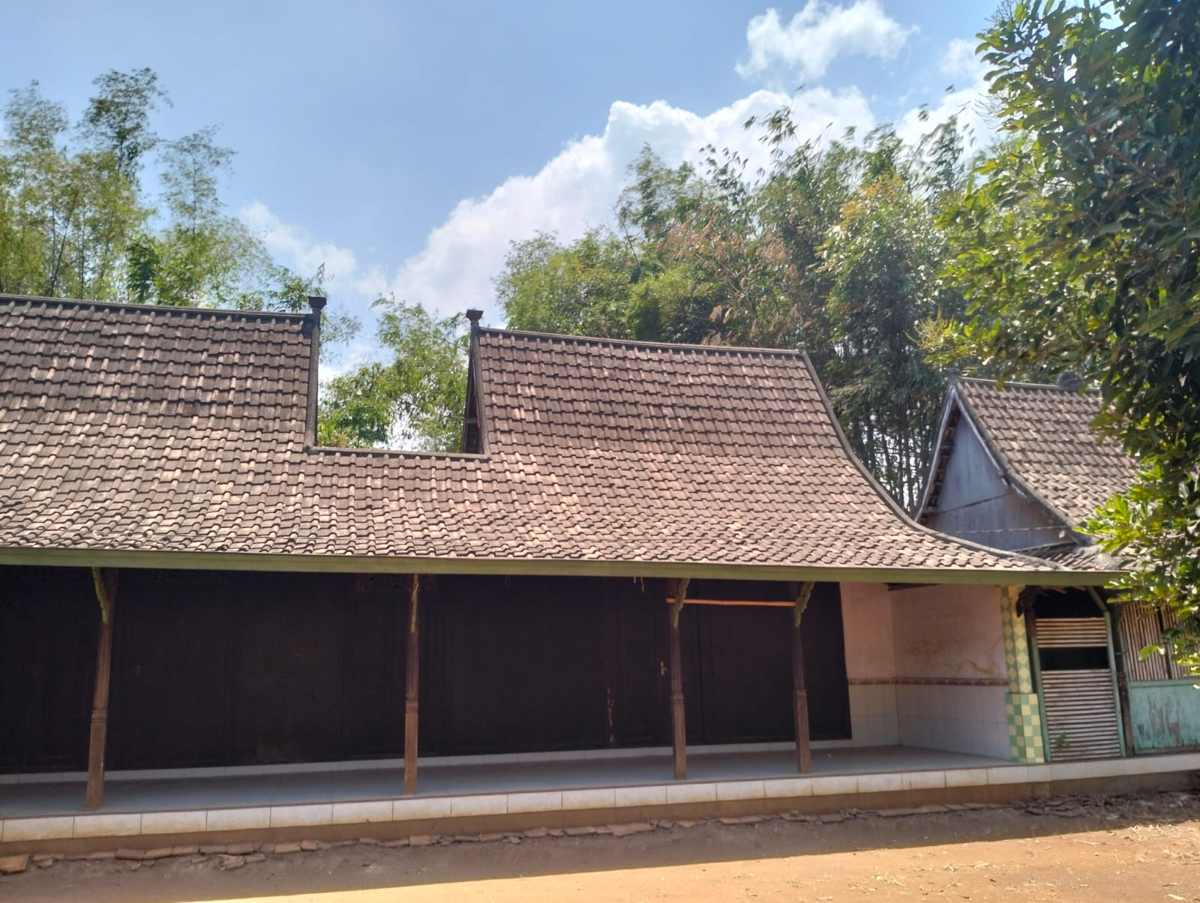
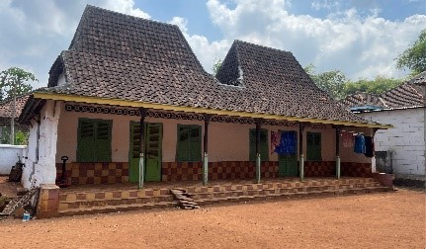
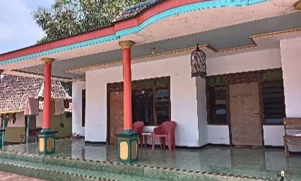
Result and Discussion
Classification
Among the 30 houses investigated, this study classified 3 types of houses based on the similarities of physical appearance of the houses.
Physically identify from the layout arrangement of the building era, the organic materials used, construction techniques, and non-physically, including the meaning and function of spaces, traditions, or culture.
Classification
(1) Traditional Style | (2) Transitional Style | (3) Development Style
Maintain the same originality of TL. | Adapted to modern design without abandoning its traditional concept. | Reflects modern local expertise with the acculturation of global cultures.
Adapting Modernization in Traditional Architecture | Didit Novianto

Slide 6
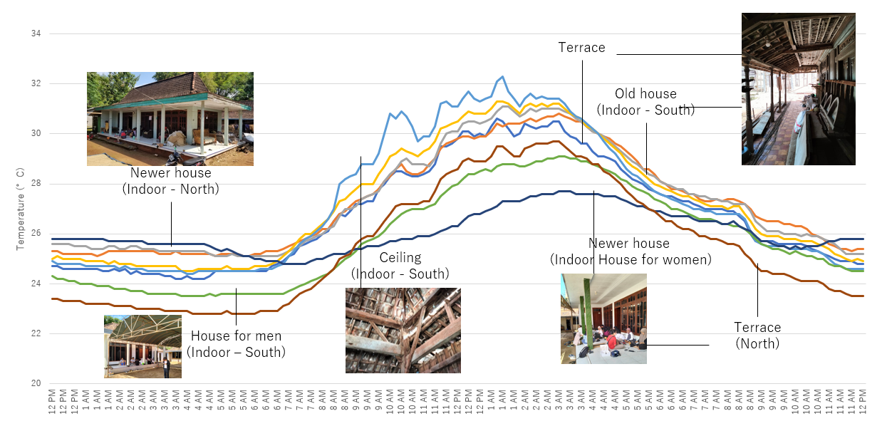
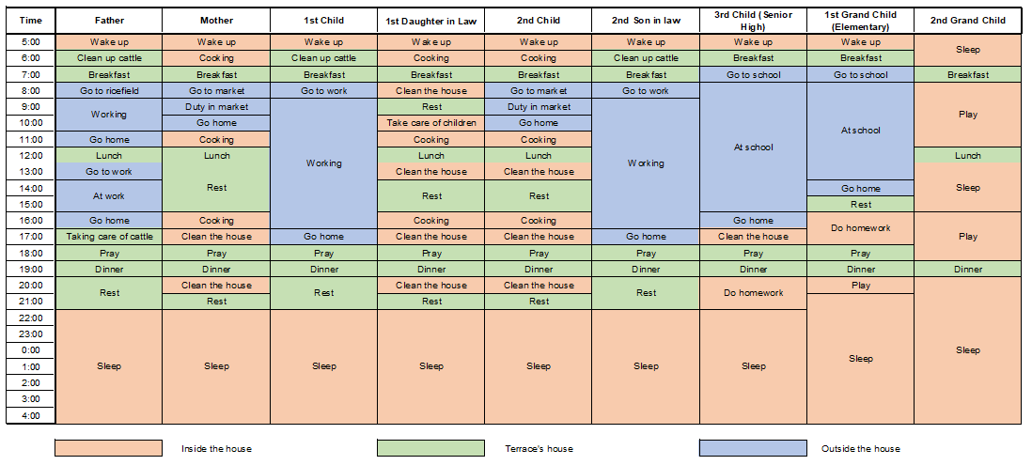
Result and Discussion
Environmental Measurements
Conducted scientific measurements using devices that record temperature and humidity data in several rooms within the TL house object, the result shown in the graph below (Figure 2)
Occupants’ Lifestyle
The observation of the houses and interviews' result with TL occupant are shown in Figure 3, The lifestyle includes using outdoor and transitional spaces rather than spending time inside the house, except at night.
Figure 2. Thermal Living Environment Measurement
Table 1. Occupancy and lifestyle of case study
Adapting Modernization in Traditional Architecture | Didit Novianto

Slide 7
Conclusion
Culture and modernization in TL
The arrangement of houses in TL is a manifestation of Madura culture and philosophy, embodied in building regulations and maintaining sustainability, both environmentally and culturally. This is why modernization to date has only affected the material aspects and components, without altering the layout and the appearance of architectural elements.
TL's space and user activities
From the confirmation obtained through interviews with the occupants, they feel that the terrace space is the most thermally comfortable and supports social interaction among each other. As a result, most activities from morning to evening take place on the terrace around the inner court, or in front of the building.
The layout of TL
The layout of the buildings, with separate structures and an open area in the center, allows air to flow through the spaces. This design helps create a comfortable microclimate, making it more bearable even during the typically hot weather in Madura.
Adapting Modernization in Traditional Architecture | Didit Novianto

Slide 8
References
[1] M. Mansur, “Wisdom In Approaching Nature And Tourists In The Tanean Lanjhang Madura Ecosystem,” Center for Open Science, 2021.
[2] L. Tulistyantoro, “Makna Ruang Pada Tanean Lanjang Di Madura,” Dimensi Interior, vol. 3, no. 2, 2005.
[3] M. Mansur, R. Muhtadi, K. Kamali, and A. Rofiki, “Model Local Culture Tourism Berbasis Tanean Lanjhang Desa Larangan Luar Pamekasan,” PROFIT: Jurnal Kajian Ekonomi dan Perbankan Syariah, vol. 4, no. 2, pp. 17–40, 2020.
[4] P. Rumawan Salain, “BERKAH DAN TANTANGAN ARSITEKTUR NUSANTARA DI ERA MODERN,” 2017.
[5] F. I. Habiby, “DAMPAK PEMBANGUNAN JEMBATAN SURAMADU TERHADAP PENGEMBANGAN WILAYAH KABUPATEN BANGKALAN DITINJAU DARI TEORI HARROD-DOMAR DENGAN TEORI LOKASI WEBER,” Geografi dan Pengajarannya, vol. XVIII, 2020.
[6] N. Sa’adah, “ANALISIS DETERMINAN PEMBANGUNAN SUMBER DAYA MANUSIA DI PULAU MADURA PASCA PEMBANGUNAN JEMBATAN SURAMADU,” Journal of Development Economic and Social Studies, vol. 1, no. 1, 2022.
[7] Novianto, Didit, Rusyda Tamma Hidayat, and Syafa Ailsa Dewi Bhanuwati. "Pemetaan Arsitektur Tradisional Taneyan Lanjhang Madura: Studi Kasus Desa Alang-Alang, Kecamatan Tragah." Sewagati 8, no. 2, 2024.
Acknowledgments
Authors wishing to acknowledge assistance or encouragement from colleagues, special work by technical staff and financial support from the Directorate of Research and Community Services (DRPM) of the Institut Teknologi Sepuluh Nopember (ITS) for financially supporting our research and community service activities through the grant number 1509/PKS/ITS/2023. This research also partly supported by WCP-like program 2023.
Adapting Modernization in Traditional Architecture | Didit Novianto

