Slide 1




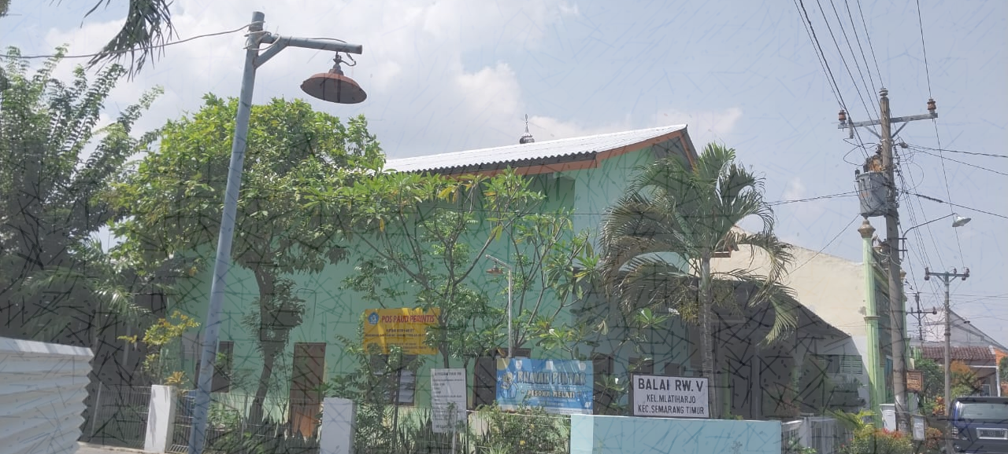

REDUCING ROOM TEMPERATURE USING BeCool REFLECTIVE PAINT COATING ON TIN AND ASBESTOS ROOF SURFACES IN SEMARANG
Ratri Septina Saraswati¹, Baju Arie Wibawa², ‪Mohammad Debby Rizani³, Beta Paramita⁴
^{1000lawang@gmail.com}
Faculty of Engineering and Informatics
Universitas Persatuan Guru Republik Indonesia Semarang
2025
International Symposium and Workshop
on Sustainable Buildings, Cities, and Communities.
“A Sustainable Cooling for Cities: Designing for Hot and Humid Climates”

Slide 2
Introduction
Coolroofs paint are applied to roofs that reflect solar heat, keeping the roof surface and the area below it cool. Reflecting a significant portion of the sun's heat reduces the temperature difference between day and night on the roof.
This is crucial for buildings without artificial air conditioner to cooling in hot. It feels to the communities in Semarang, which usually get a hot characteristic climate along the year with temperature range between 24 to 33°C.
Artificially cooled buildings will experience reduced energy consumption, used reflective paint materials are characterized by Solar Reflectance Index value (SRI), measured according to ASTM E1980.
This research is a Independent Learning Independent Kampus (MBKM) program, year 2022-2023, collaboration between Universitas Pendidikan Indonesia dan Universitas PGRI Semarang.
The goal of coolroof is to promote green buildings, sustainable buildings, and environmentally friendly buildings, as well as reduce carbon emissions (CO2) through energy efficiency in office buildings and mid-range residential buildings.
Research / Invention Title / Design / Patented Product | Lead Researcher

Slide 3
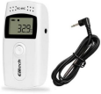
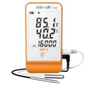

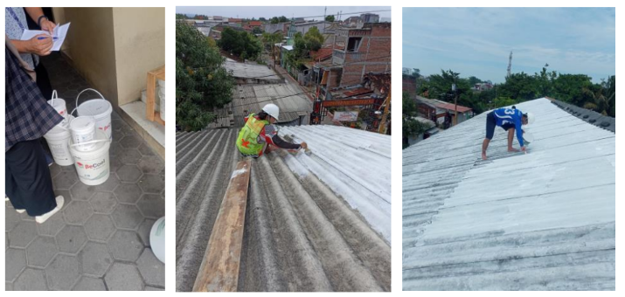
Method
Researched location : Semarang City
The Semarang environment, particularly at the research location with variable temperaturee, used the Computational Fluid Dynamics (CFD) method to compare real-world conditions. The trial consisted of comparing roof and room temperatures before and after the use of BeCool Paint, respectively on 7 buildings : with tin (zink/zincalume) roofs (5) and asbestos roofs (2)
Data collection in this study included :
measuring room temperature,
room humidity,
roof top temperature, and
roof bottom temperature
comparing roof and room temperatures before and after painted by BeCool Paint
Time : October 10, 2022 to January 15, 2023
[ 7:00 AM to 11:59 PM ]
Tools :
roof temperature meter room tempe & humidity anemometer
(Ellitech RC-4), meter (Elitech GSP 6)
MATERIAL : OBJECTS :
BECOOL PAINT REFLECTIVE ROOF PAINTING
2 buildings 5 buildings
ASBESTOS TIN ROOFS
Research / Invention Title / Design / Patented Product | Lead Researcher

Slide 4
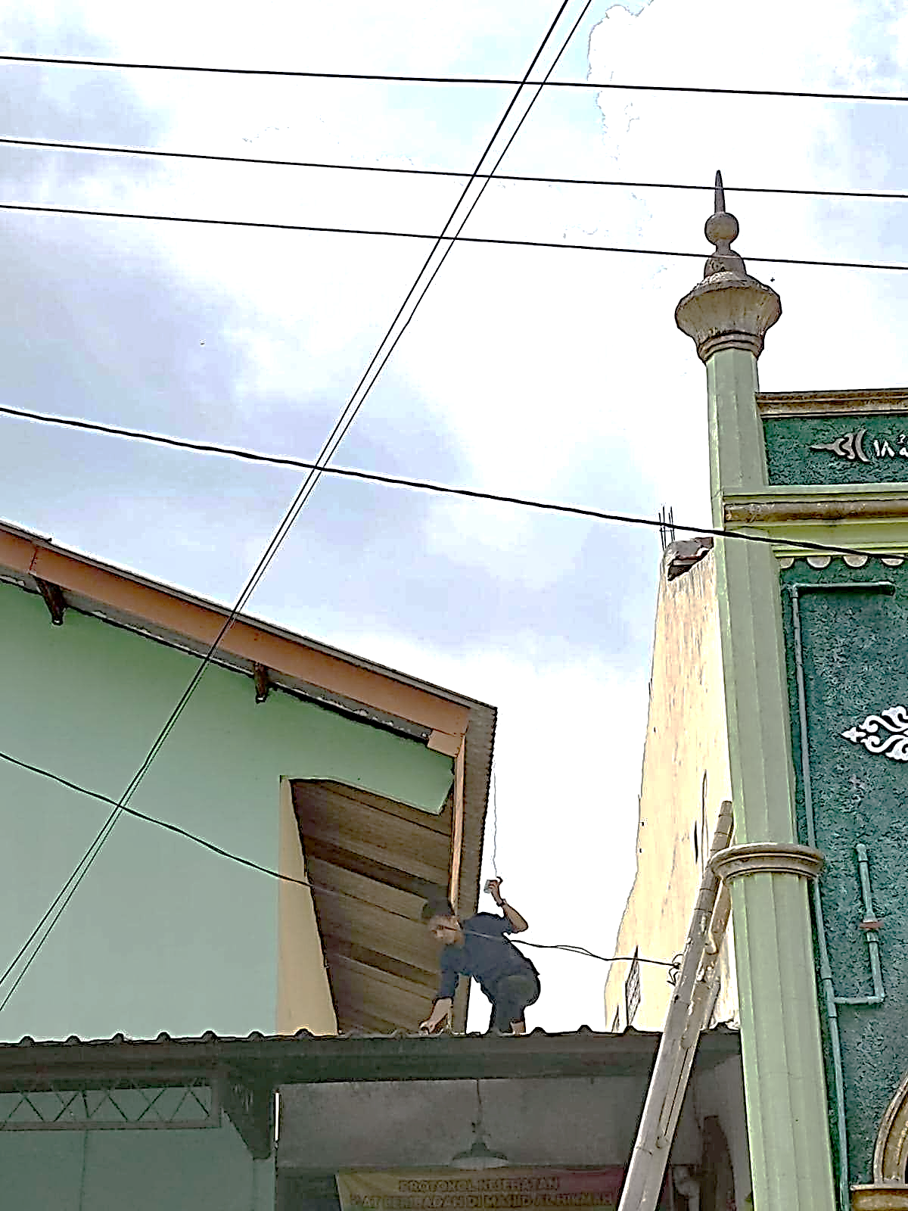
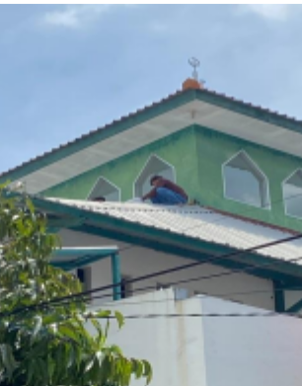
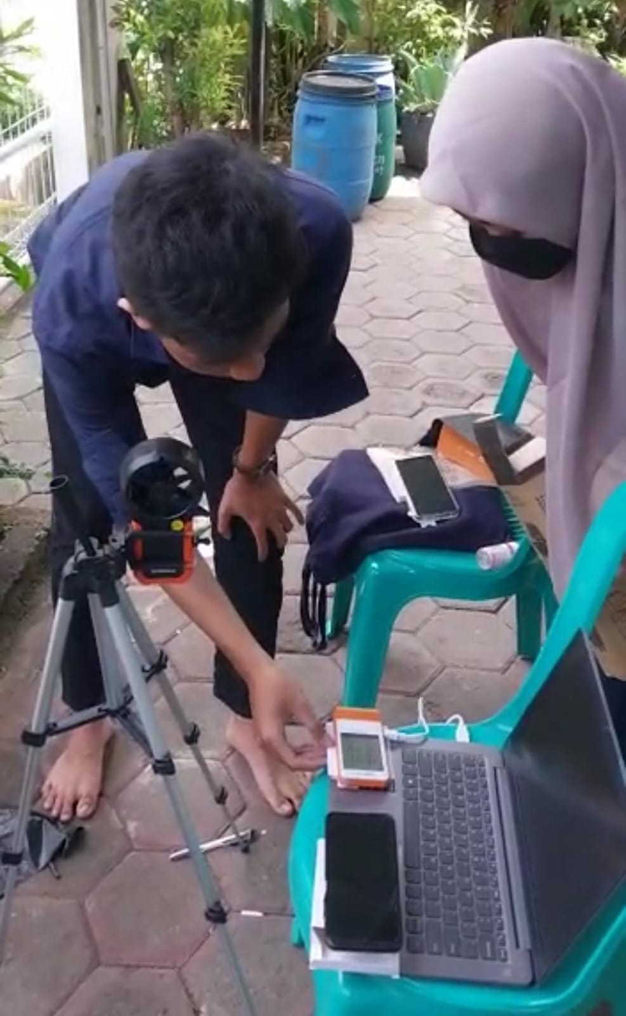
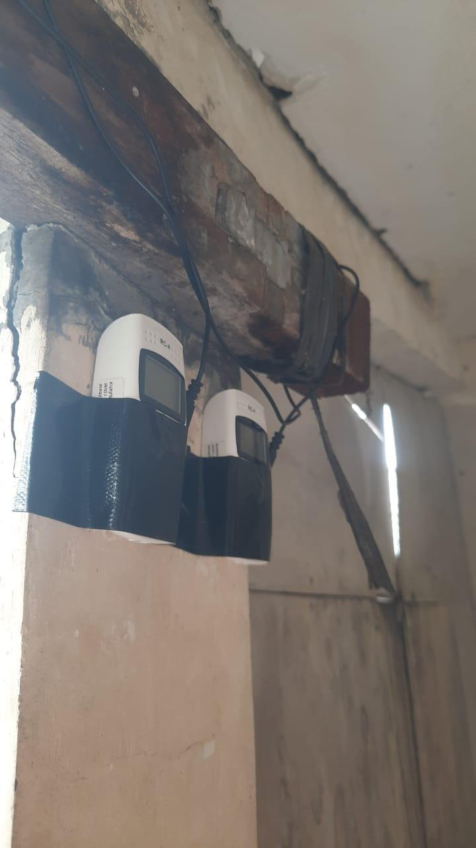
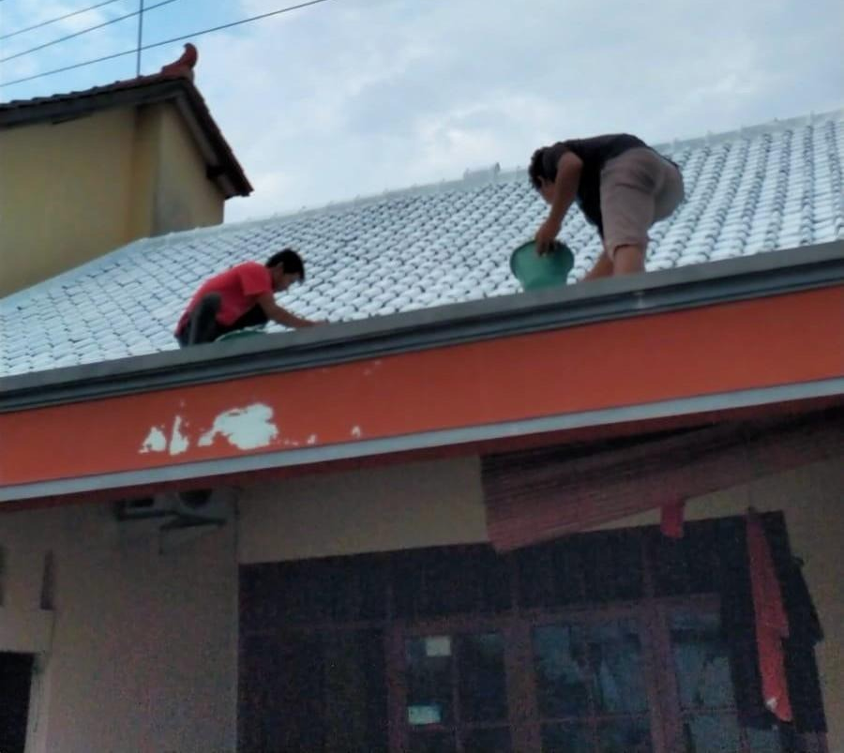
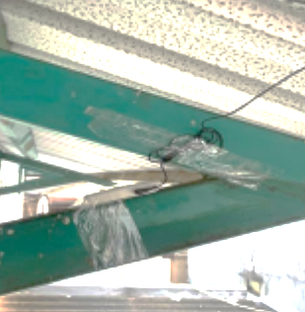
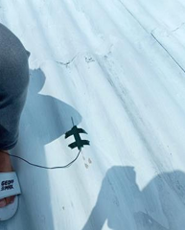
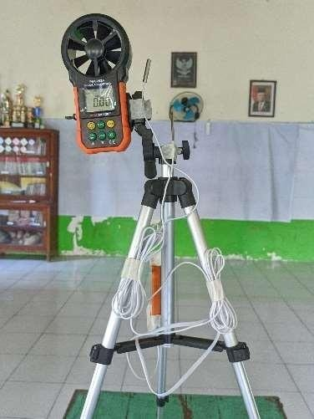
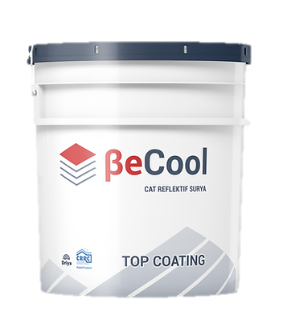
The roof temperature measurement uses Elitech RC 4 in the top and the bottom of roof surface.
The room humidity uses Elitech GSP 6, indoor air speed flow uses anemometer.
Measurement Methods
The survey methods comparing between roof temperature before and after application painted reflective roof painting.
BeCool Paint applied on the roof surface by 2 layers: base layer and continuing with finishing layer.
Research / Invention Title / Design / Patented Product | Lead Researcher

Slide 5
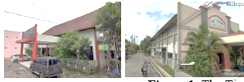
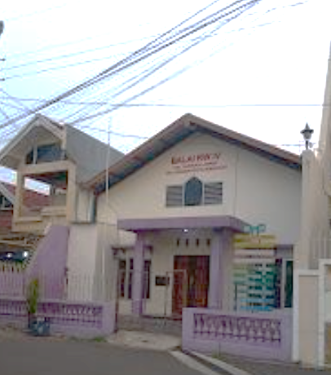
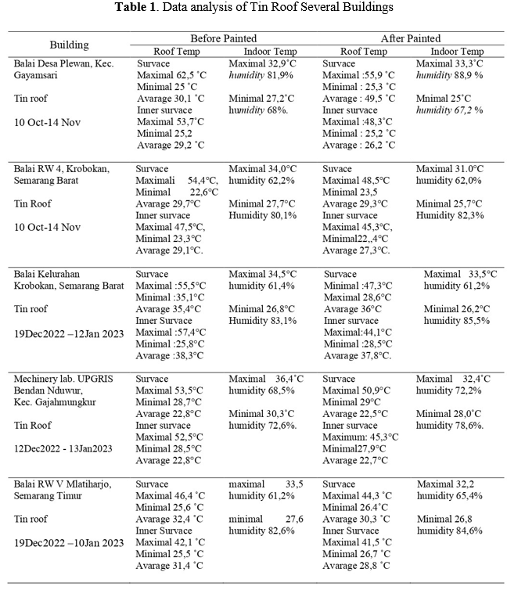
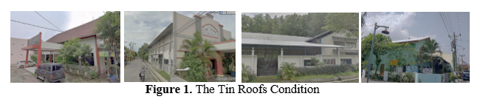
Result and Discussion
Tin roof
the tin roof, could reduce heat :
top roof surface : 0,3 to 7,3°C
inner roof surface : 1,2 – 7,2°C
reduce indoor (room) temperature range
between -0,4 - 3°C and different humidity 0,2 – 4,2%.
Research / Invention Title / Design / Patented Product | Lead Researcher

Slide 6
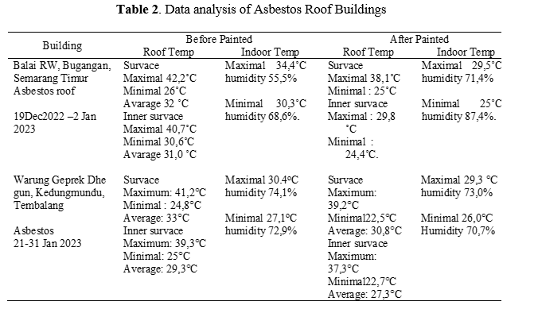
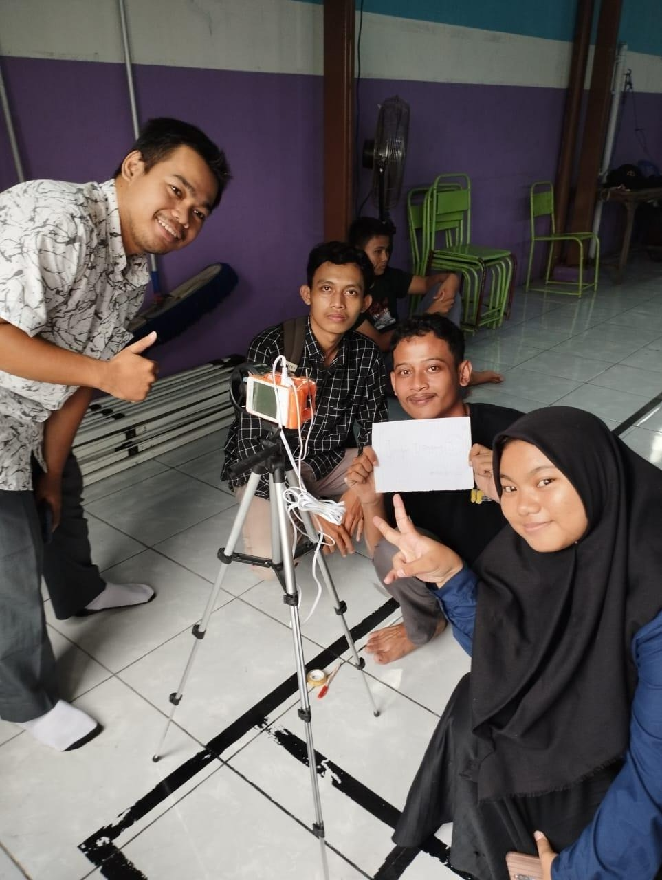
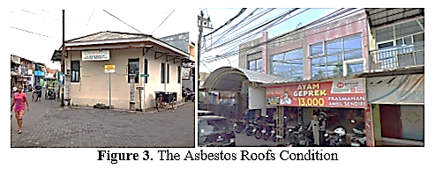
asbestos roof
the asbestos roof, could reduce heat :
ttop roof surface heat :1 – 16,4˚C
inner roof surface : 2-10,9˚C
reduce the room temperature (indoor) maximal range at 0,7-5,5 °C and difference humidity about 4.5-18,8 %.
Research / Invention Title / Design / Patented Product | Lead Researcher

Slide 7
Conclusion
the application of solar-reflective paint can reduce the roof temperature
BeCool reflective painted on the asbestos roof temperature until 16,4˚C for the top roof surface, 10,9˚C for the inner roof surface, and reduce indoor temperature until 5,5°C. BeCool also reduce the tin roof temperature until 7,3°C for the top surface, 7,2°C for the inner surface, and reduce indoor temperature until 5,5°C different humidity 0,2 – 4,2%.
BeCool Paint is more effective in reducing heat on the asbeston roof rather than the tin roofs.
It is suggested that time schedule could be application in the dry season : to get more accurate data comparison. Because in this research we found some different calculation results, that there were cases of roof temperature increase after painting. The inconsistency data caused by climate fluctuation during measurement, because the research was conducted at the start of the rainy season, with variable weather conditions. Another difficulties because we choosed buildings with the very high roof slope.
Solar-reflective paint offers a good alternative rather than air conditioning system and electrical fans (which need electrical energy) for heat reduction purposes.
Research / Invention Title / Design / Patented Product | Lead Researcher

Slide 8
References
Jacobus Samidjo dan Yohanes Suharso. 2017 | Memahami Pemanasan Global dan Perubahan Iklim”. IKIP Veteran Semarang. 36-38
Istiningrum, Demi Tria Iklim (2017) | .“Kajian Kenyamanan Termal Ruang Kuliah pada Gedung Sekolah C lantia 2 Politeknik Negeri Semarang.” Wahana TEKNIK SIPIL Vol. 22 No. 1 Juni 2017. 1-12.
Paramita, Beta. 2024 | “Energy yield of solar PV in 34 Indonesian cities with respect to various roof pitches and orientations.” International journal of Environmental Science and Technology”. Volume 22. 11253–11266.
Nurazizah, Siti,. 2020 | “Analisis Kenyamanan Termal Ruang Dosen Menggunakan CBE Thermal Comfort.” Semarang: Universitas PGRI Semarang.
Beta Parmita, 2025. | . “Building climate resilience in Indonesia: The role of cool roofs.” Field Actions Science Reports Special Issue 27 | 2025. Health and the environment: understanding, anticipating and acting in the face of climate change.
Tio Piccaso, 2025 | . Analysis of Thermal Comfort Changes Before and After Becool Paint Application at the Nurul Iman Karangmulya Al-Quran Education Park. Zonasi Architecture Journal. Vol 8, No.3. Universitas Pendidikan Indonesia.
Karisma, Nova, 2020. | “Efektifitas Penggunaan Cat Be Cool Pada Atap Pada Bangunan Rumah Makan Geprek Dhe Gun Kota Semarang Terhadap Perubahan Suhu Ruangan.” Umpak - Jurnal Arsitektur dan Lingkugan Binaan Vol. 3 No. 2. 97-103.
Yin Wai, Cheuk, 2025 | “Experimental Analysis of Cool Roof Coatings as an Urban Heat Mitigation Strategy to Enhance Thermal Performance”. Buildings. Published by MDPI Vol.15 Issue 5, 2025.
Cahyo, Eko, 2010 | “Pengaruh pemanasan global terhadap lingkungan bumi”. Berita Dirgantara. Volume 8 Issue 2.
A G Djafar, N Pratiwi, 2024 | “Thermal Performance of Becool-Roof Coating in Reducing Heat Gain on Fisherman’s Settlement of Gorontalo City”. IOP Conf. Series: Earth and Environmental Science 2024. 1-10.
ACKNOWLEDGEMENTS
We would like to thanks to the Independent Campus Program (MBKM) Global Warming Disaster Mitigation at the Universitas Pendidikan Indonesia (UPI) in 2022, initiated by Dr. Beta Paramita and her team.
This research involved UPGRIS, which provided lecturers and students with the opportunity to attend a class briefing, provided measurement equipment, and provided funding for this conference. We also extend our thanks to the students of the Faculty of Engineering and Informatics who participated in this research program for their hard work in conducting the field research.
Research / Invention Title / Design / Patented Product | Lead Researcher

